Slide 1
Hempsted Playgroup Autumn Seek and find sponsor Sheet Good luck and have lots of fun
Name : | Amount: | Paid:
Thank you so much for taking part,
all proceeds go towards replenishing the resources Hempsted Playgroup.

Slide 2
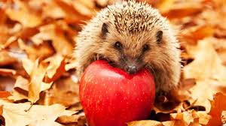
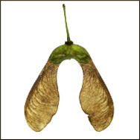
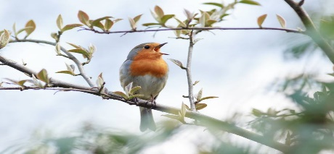
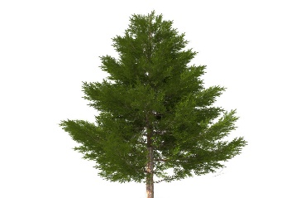
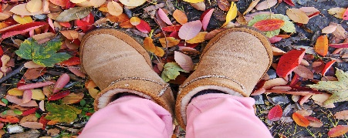
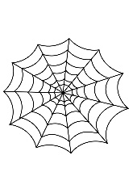
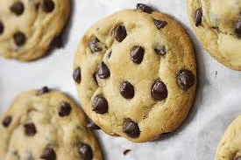
Hempsted Playgroup Autumn Seek and find sponsor Sheet Good luck and have lots of fun
Write how many conkers you find? | Glue a sycamore seed here. | Feel the wind in your hair.
Listen to the birds singing. | Draw a rainbow. | Find a pine tree?
Draw a spider. | What noise did the leaves make under your feet.? | Smell a flower.
Find a feather. | Stick a yellow leaf here. | Look for a spider web.
Glue something orange here. | Bake some cookies. | Find a circle, where was it?

